Slide 1
CONSTRUCTION DATA MINING
Comparative study of classification models for fatal accidents in construction sites based on event abstract description records
건축공학과 석사과정
22221845/키앙

Slide 2
CONTENT
INTRODUCTION
METHODOLOGY
DATA COLLECTION
DATA PREPROCESSING
MODEL CONSTRUCTION
RESULT & DISCUSSION
CONCLUSION

Slide 3
1. INTRODUCTION
Background:
As construction projects have been evolved for the better, the number of accidents in construction has become a great concern for safety management
The rate of fatal accidents was the highest in the construction industry in most parts of the world. (Chiang et al., 2017)
Consequently, many studies regarding fatality in construction sites have been addressed in the academy
Causal Factors to relatively severe construction accidents were analyzed and found to be worker actions, risk management, immediate supervision, the usability of materials or equipment, local hazards, worker capability, and project management. (Winge et al., 2019 )
Construction accident was indicated to have a strong impact on construction productivity. (Nguyen et al., 2020)
Machine learning methods have been implemented to define fatal accidents and prevent future occurrences in many studies.
Recent Studies:
Author | Method
Yan et al. | Logistic Regression
Gregoriades A, Mouskos K | Bayesian networks
Yeoum S & Lee y | ANN, Logistic Regression
Tixier A et al. | Random Forest, Stochastic gradient tree boosting
Amiri et al. | Bayesian networks

Slide 4
1. INTRODUCTION
Problem Statement:
Many research has investigated many factors concerning fatal accident, but textual description was not yet involved in classification study.
Textual description of accident situation and personal information could be valuable for fatal classification study. (Choi et al.,2020)
Activity characteristics should also be identified as influential factors in predicting fatal accidents (Xu & Kaili)
Project objectives:
Comparative studies of 4 classification methods for fatality in construction accidents model from textual description
Classification model is made to aid safety managers in accurately allocating their crew for better performance and safety accordingly to activity risk.
To raise awareness of fatal accidents by considering the relationship between events, human and fatal accidents.
Assisting in risk assessment for further study related to labor productivity prediction in the construction site to improve construction performance

Slide 5
2. METHODOLOGY
Data Collection
Data Pre-Processing
Variable Selection
Training Model
Grid Search
Cross Validation
Evaluation
Model Comparison
Feature Importance
Decision Tree
Random Forest
Gaussian Naïve Bayesian
Conclusion
Recursive Feature Elimination (RFE)
SMOTE
Support Vector Classifier
Models Construction

Slide 6
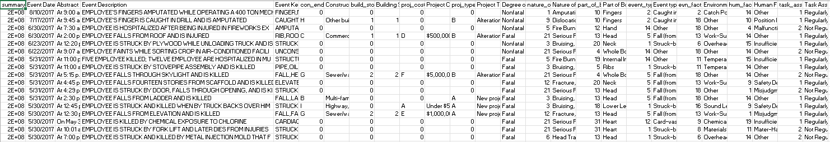
3. DATA COLLECTION
Abstract Text Sample
Accident #1: At 4:00 p.m. on May 25, 2017, an employee was performing clean up of a work area. The employee fell through a floor opening/shaft. The employee struck rocks on the ground, received head trauma and broken bones, and was killed.
Accident #2: At 2:00 p.m. on April 25, 2017, Employee #1, an electrician's helper, was trying to move electrical switch gear off of a pallet. The switch gear weighed 300 pounds. As Employee #1 started to move the switchgear, it tipped over on him, fracturing his ribs.
4829 accidents dataset collected by OSHA (Occupational Safety and Health Administration) in the U.S.
Unstructured text abstracts of the incident which includes Degree of Injury of accidents as Dated between 2015-2017

Slide 7
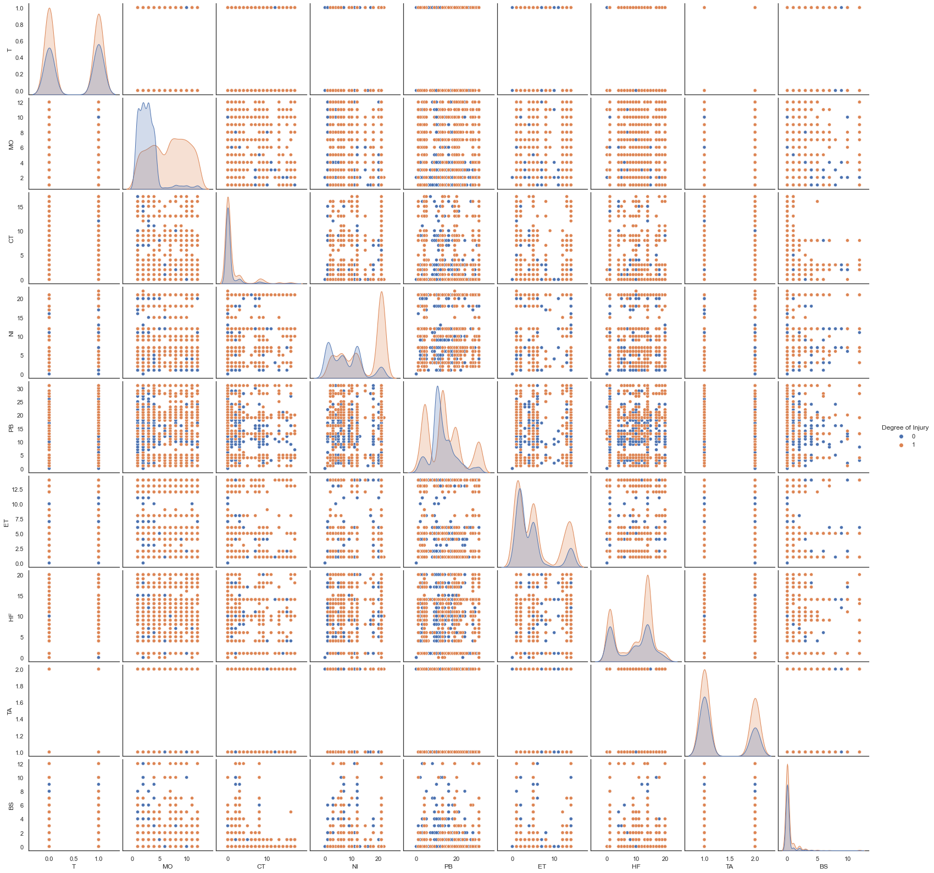
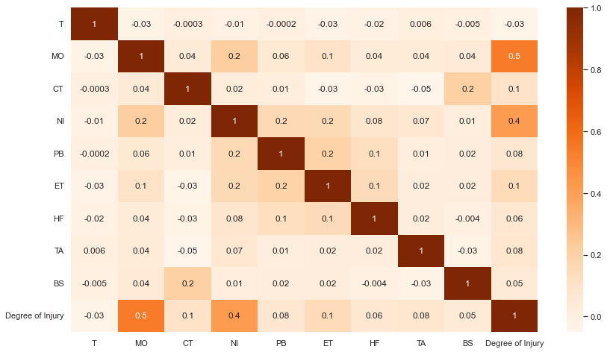
3. DATA COLLECTION
Data Visualization
Correlation Heatmap
Attributes Pair-Plots

Slide 8
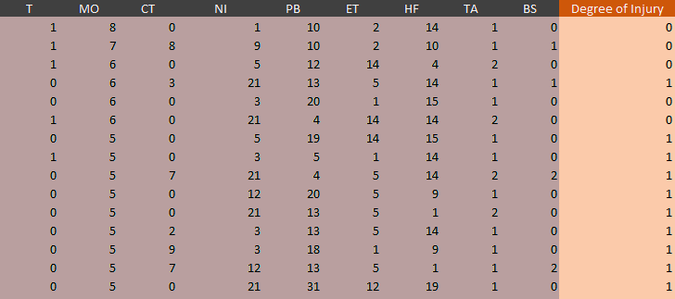
4. DATA PREPROCESSING
Data Encoding
Accident time assumption with missing information
Visualizer and remove Irrelevant variables such as Accident ID
Rearrange the dataset
VARIABLES | STRING | Label Encode
Construction Type (CT) | New/Maintenance/Rehabilitation | 0-17
Building Story (BS) | 1-10, >10 | 0-12
Nature of Injury (NI) | Fracture, Broken Bones ; Serous Fall/Strike; Buising,contusion ,etc | 0-22
Part of body (PB) | Head, Feet,Heart,Ribs,etc | 0-31
Event Type (ET) | Fall, Struck-by, Caught in between, Other | 0-14
TIME (T) | AM or PM | 0,1
MONTH (MO) | January - December | 1-12
Human Factor (HF) | Misjudgment, Hazardous Situation; Safety Devices Removed/Inoperable; etc | 0-20
Task Assignment (TA) | Regularly Assigned, Not Regularly Assigned | 0,1
Degree of Injury(DI) | Fatal, Non-Fatal | 0,1
Project
Event
Human

Slide 9
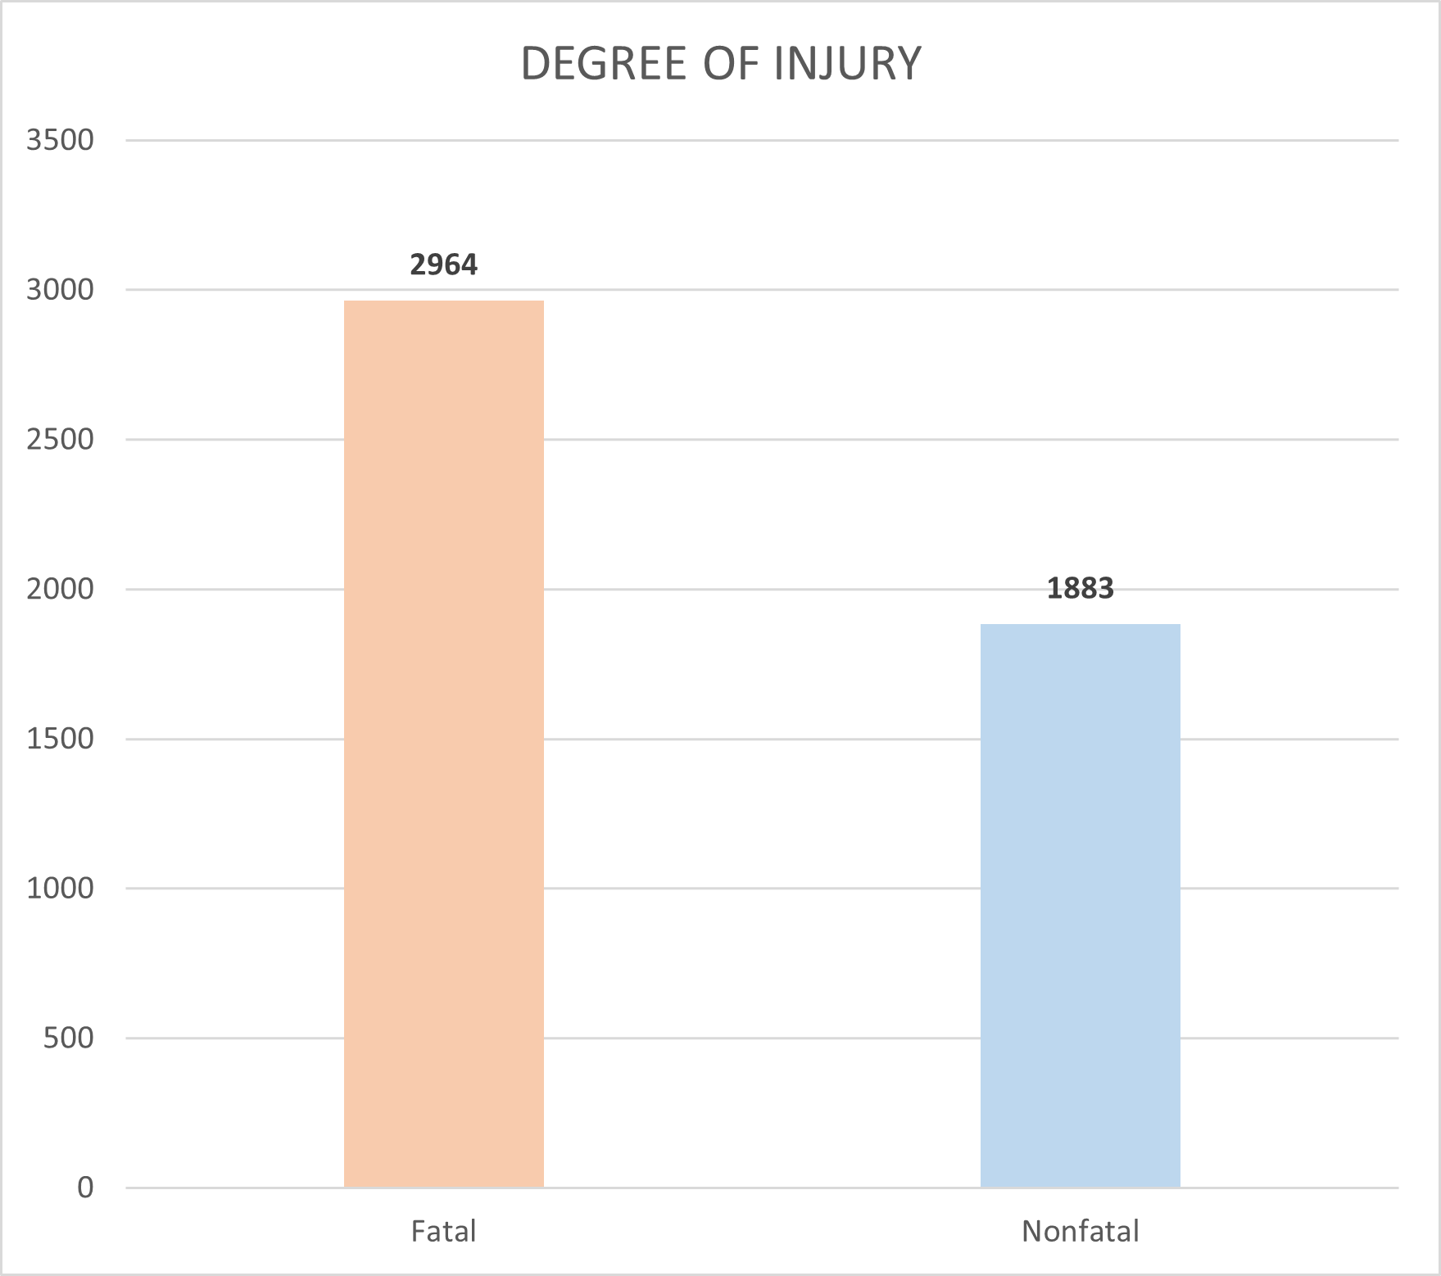
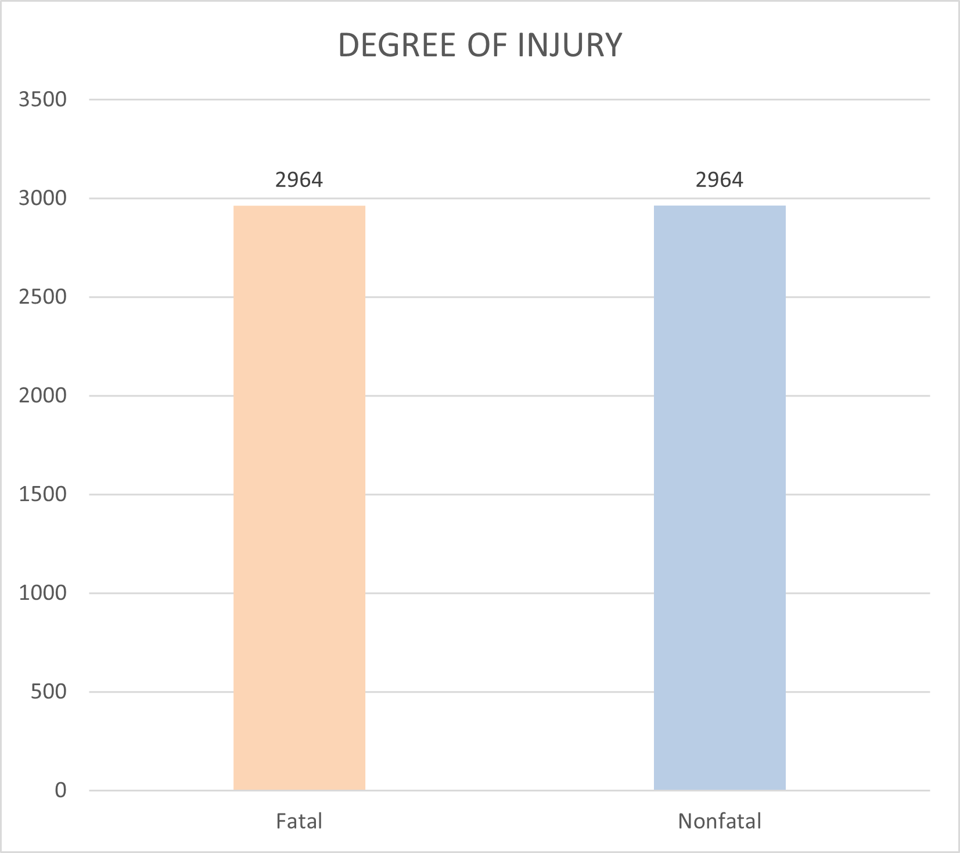
5. DATA PREPROCESSING
Oversampling
RFE analysis
Employ oversampling technique SMOTE to deal with class imbalance
Oversample generates artificial datas to balance the class in classification study.
Employ Recursive Feature Elimination (RFE) technique with Random Forest Estimator
Eliminate one variable and evaluating the model at a time
Number of Variables | Accuracy | Recall
3 | 0.89 | 0.89
4 | 0.89 | 0.88
5 | 0.87 | 0.86
6 | 0.88 | 0.86
7 | 0.87 | 0.85
8 | 0.87 | 0.84
9 | 0.87 | 0.85

Slide 10
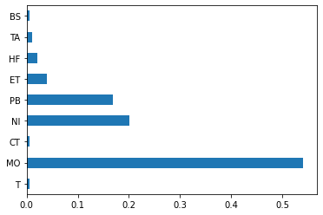
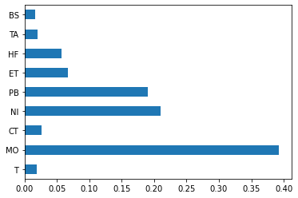
5. MODEL CONSTRUCTION
Decision Tree
Random Forest
Features Importance
Features Importance
Hyperparameters | Value
max_depth | 5-10
min_samples_leaf | 10-30
max_features | 3-9
Hyperparameters | Value
max_depth | 5-10
min_samples_leaf | 10-30
max_features | 3-9
n_estimators | 5-20

Slide 11
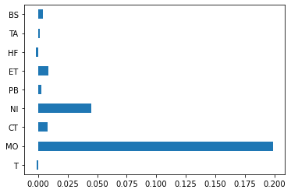
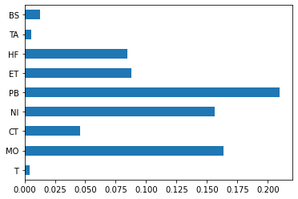
5. MODEL CONSTRUCTION
Gaussian Naive Bayesian
Support Vector Classifier
Features Importance
Features Importance
Hyperparameters | Value
var_smoothing | [0,90,100]
Hyperparameters | Value
C | 1-8
gamma | 0.08,0.1,0.005
kernel | RBF

Slide 12
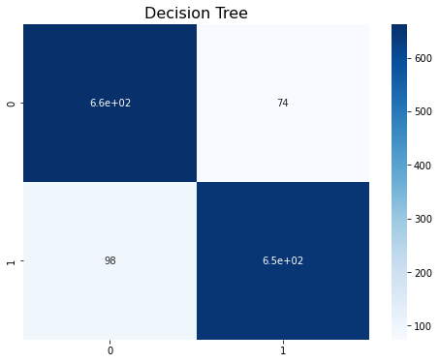
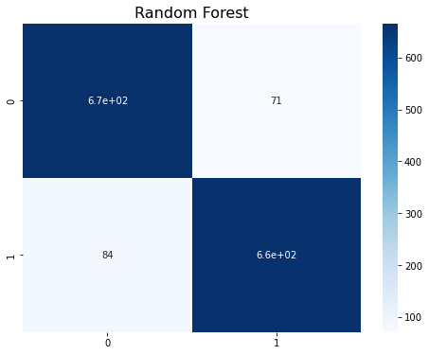
5. MODEL CONSTRUCTION
Accuracy : 0.88
Recall : 0.87
Hyperparameter: Max_Depth =8, Max_Features = 8, Min_Sample_leaf =10
Accuracy = 0.90
Recall = 0.90
Hyperparameters: bootstrap= False, max_depth=None, max_features = 6, min_samples_leaf = 5,n_estimators = 6

Slide 13
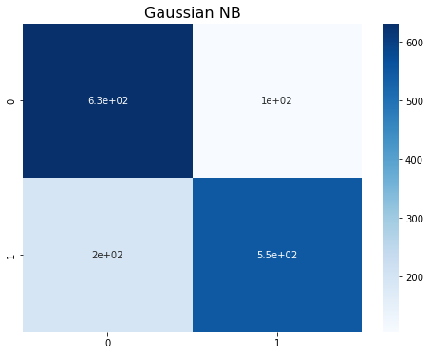
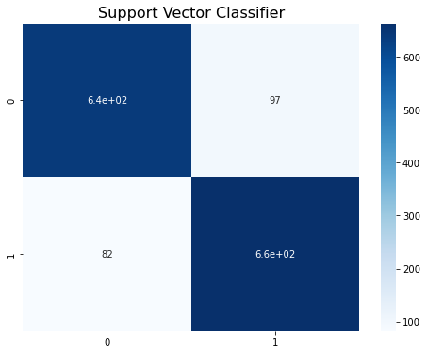
5. MODEL CONSTRUCTION
Accuracy : 0.80
Recall : 0.75
Hyperparameter: var_smoothing = 0.015199
Accuracy = 0.88
Recall = 0.89
Hyperparameters: Kernel = rbf, C= 3, gamma =0.08

Slide 14
6. RESULT & DISCUSSION
METHOD | VARIABLES | ACCURACY | RECALL
Decision Tree | All, except T | 0.88 | 0.87
Random Forest | MO,NI,PB,ET,HF,TA | 0.90 | 0.90
Gaussian Naïve Bayesian | MO,NI,ET,CT | 0.80 | 0.75
Support Vector Classifier | MO, CT,NI,PB,ET,HF | 0.88 | 0.89
4 models yielded similar accuracy and recall rate, but random forest yielded the highest with both accuracy and recall around 0.9.
Different models use different features to make classification
Every feature in SVM has a similar importance value
SVM and Random Forest training time was the longest due to the numbers of hyperparameters of those models
Month, Nature of Injury, and Part of body, were significant factors respectively in 4 models
Surprisingly, Task Assignment variable was NOT found to be much significant in fatal accident

Slide 15
6. CONCLUSION
Comparison study between 4 models were developed to get a highly accurate classification model for fatal accidents on the construction site.
Evidently, this method has cross-checked the fact that accident event description can also be incorporated to make fatal accident classification models
The model is expected to assist site managers to allocate their crew efficiently to avoid a future accidents
It should be also noted from the result that fatal accidents could happen regardless of how frequent the task is assigned to a specific crew
The model can be used to make risk assessments in productivity analysis to better cost and schedule performance
Limitations
Due to small sets of data, and location-constraint, this model can not be generalized.
Number of variables to use is still limited which results in RFE similar accuracy. Therefore, larger dataset with more diverse attributes are needed to better the application of the classification model.
SMOTE generates artificial data which is still uncertain to some extent.

Slide 16
Reference
Amiri, M., Ardeshir, A., Fazel Zarandi, M. H., & Soltanaghaei, E. (2015). Pattern extraction for high-risk accidents in the construction industry: a data-mining approach. Http://Dx.Doi.Org/10.1080/17457300.2015.1032979, 23(3), 264–276. https://doi.org/10.1080/17457300.2015.1032979
Choi, J., Gu, B., Chin, S., & Lee, J. S. (2020). Machine learning predictive model based on national data for fatal accidents of construction workers. Automation in Construction, 110. https://doi.org/10.1016/j.autcon.2019.102974
Gregoriades, A., & Mouskos, K. C. (2013). Black spots identification through a Bayesian Networks quantification of accident risk index. Transportation Research Part C: Emerging Technologies, 28, 28–43. https://doi.org/10.1016/J.TRC.2012.12.008
Tixier, A. J. P., Hallowell, M. R., Rajagopalan, B., & Bowman, D. (2016). Application of machine learning to construction injury prediction. Automation in Construction, 69, 102–114. https://doi.org/10.1016/J.AUTCON.2016.05.016
Xu, Q., & Xu, K. (2021). Analysis of the characteristics of fatal accidents in the construction industry in china based on statistical data. International Journal of Environmental Research and Public Health, 18(4), 1–21. https://doi.org/10.3390/ijerph18042162
Yeoum, S. J., & Lee, Y. H. (2016). A STUDY ON PREDICTION MODELING OF KOREA MILLITARY AIRCRAFT ACCIDENT OCCURRENCE. International Journal of Industrial Engineering: Theory, Applications, and Practice, 20(9–10). https://doi.org/10.23055/ijietap.2013.20.9-10.1138

